Slide 1


SPAM DETCTION IN SMS (TEXT)
USING MACHINE LEARNING
Presented by: batch 7
Bharadwaj Nadiminti
Ganji Beulah Christiana
Kanumilli Sasi vinay
Kotana Jahnavi
Paidi Charan raj

Slide 2

CONTENTS:
INTRODUCTION
PROBLEM STATEMENT & PURPOSE
CHOOSING ALGORITHM
METHODOLOGY
DESIGN OF THE SYSTEM
WEBPAGE DESIGN
OUTPUT
CONCLUSION

Slide 3
INTRODUCTION
E- messages are an important means of communication between millions of people worldwide.
But several people and companies misuse this facility to distribute unsolicited bulk messages that are commonly called as spam sms.
Spam sms may include advertisements of drugs, software ,adult content ,health insurance or other fraudulent advertisements.
These spam SMS might lead to Financial loss ,Corruption of Data, Data Theft etc..

Slide 4

WHAT IS SPAM?
Spam messages as usually classified as:
Unwanted messages from untrusted sources.
Messages that usually to lead to phishing sites.
The amount of mobile spam varies widely from region to region.
Spam messages can be sent by anyone, even without a short-code.
Projected to account for half of all mobile phone traffic in 2019.
In parts of Asia up to 30% of messages were spam in 2012.

Slide 5

PROBLEM STATEMENT
As Spam SMS are increasing day by day , due to which there is huge increase in fraudlent activities in and around the World.
These spam SMS might lead to Financial loss ,Corruption of Data, Data Theft etc..
Our Motto is Design a System which can detect the SMS as a Spam or Ham using Machine learning Techniques.

Slide 6
Understanding the problem is a crucial first step in solving any machine learning problem. We will explore and understand the process of classifying emails as spam or not spam. This is called Spam Detection, and it is a binary classification problem.
The reason to do this is simple: by detecting unsolicited and unwanted emails, we can prevent spam messages from creeping into the user’s inbox, thereby improving user experience.

Slide 7
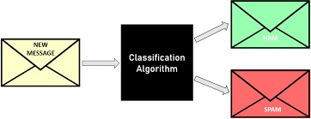

Slide 8
DIFFERENT APPROCHES TO SOLVE THE PROBLEM
Logistic regression
K-nearest neighbours
Naïve bayes classifier
Support vector machine
Decision tree classifier

Slide 9
Reason for choosing SVM
Experiment results demonstrate that SVM-NB can achieve a higher spam-detection accuracy and a faster classification speed.
SVM is a very good algorithm for doing classification. ...
The main advantage of SVM is that it can be used for both classification and regression problems. SVM draws a decision boundary which is a hyperplane between any two classes in order to separate them or classify them.

Slide 10

Support Vector Machine
Support Vector Machine or SVM is one of the most popular Supervised Learning algorithms, which is used for Classification as well as Regression problems.
SVM chooses the extreme points/vectors that help in creating the hyperplane. These extreme cases are called as support vectors, and hence algorithm is termed as Support Vector Machine. Consider the below diagram in which there are two different categories that are classified using a decision boundary or hyperplane:

Slide 11
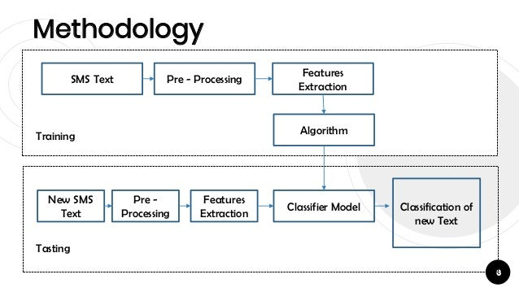
METHODOLOGY

Slide 12
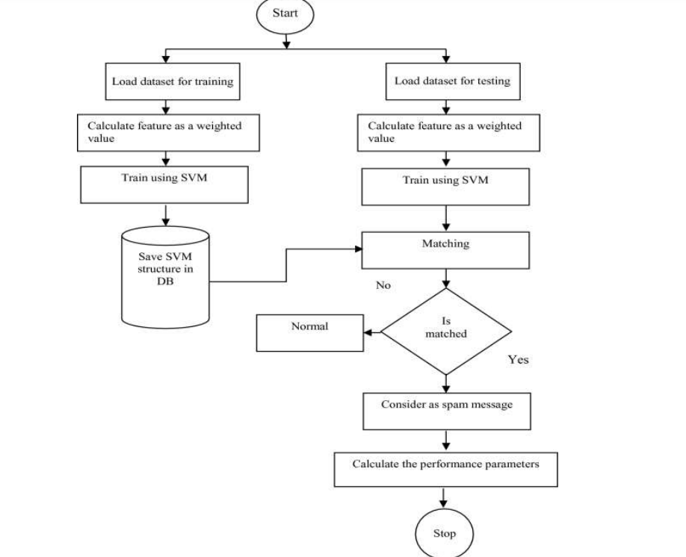
STEPS INVOLVED
Getting the dataset
Importing libraries
Importing datasets
Finding Missing Data
Encoding Categorical Data
Splitting dataset into training and test set
Feature scaling

Slide 13
The dataset is of 5574 text messages from uci machine learning repository gathered in 20122. sms spam classifier data set from uci machine learning repository “https://archive.ics.uci.edu/ml/datasets/SMS+Spam+Collection”
DESCRIPTION OF DATASET
TOTAL DATASET | 5574
SPAM | 747
NON SPAM(HAM) | 4827
LABEL | PERCENTAGE IN DATASET
SPAMS | 13.40
HAMS | 86.60

Slide 14
PREPROCESSING
The pre-processing phase is important because it moulds the data by cleaning, integrating, transforming, reducing, and discretizing.
The attribute “text” contains the message strings. This message strings need to be converted into word vectors representation.
The TF-IDF technique is applied to convert the strings data, and the tokenization methods are used to remove the symbol such as.,;: ‘"()?!\/#&*+-_|@.
For feature selection, the Information Gain technique is used to rank the feature based on the higher frequency order.

Slide 15
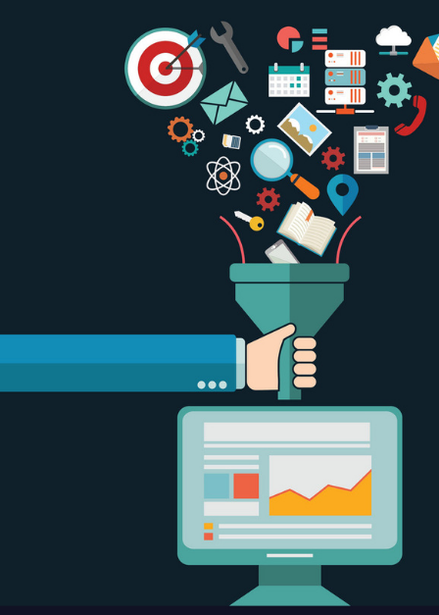
1. Case Folding Dan Characters Erase
2. Tokenization
3. Handle Slang Words
4. Stop-word Removal
5. Stemming
6. Handle Number

Slide 16
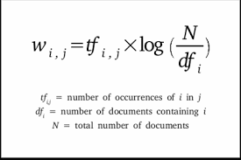
TF –IDF VECTORIZER
Convert a collection of raw documents to a matrix of TF-IDF features
Term frequency-inverse document frequency is a text vectorizer that transforms the text into a usable vector. It combines 2 concepts, Term Frequency (TF) and Document Frequency (DF). The term frequency is the number of occurrences of a specific term in a document.

Slide 17
PACKAGES USED
Flask : it is for creating the application server and pages.
nltk : it is for natural language operations.
Numpy : it is for array computation.
Pandas : it is for manipulating and wrangling structured data.
Pickle : it is for serializing and deserializing python objects , that is to convert python objects like lists ,dictionaries etc into byte streams.

Slide 18
DESIGN OF THE SYSTEM
The constructed system generally consists of two phases, namely the training and testing process and general design of the system
Training Data
The observations in the training set form the experience that the algorithm uses to learn. In supervised learning problems, each observation consists of an observed output variable and one or more observed input variables.
Test Data
The test set is a set of observations used to evaluate the performance of the model using some performance metric. It is important that no observations from the training set are included in the test set.

Slide 19
HOW TO TRAIN A CLASSIFIER?
Summary: We need way to know probability of an message that is either spam or not, by using each word from our dataset
Our theory is that a message would be categorized as spam if a contains words that are associated with spam message
For every message in our dataset, we’ll take EVERY word, and make a guess that the word is contained most often
from sklearn.model_selection import train_test_split
X_train, X_test, y_train, y_test = train_test_split(X, y, test_size=0.20, random_state=0)

Slide 20
BUILDING A SPAM CLASSIFIER
WHAT IS A CLASSIFIER?
Type of model that is able to detect whether a given set of features is predicted from a label
A feature is each SMS message
A label is “spam” or “ham”
from sklearn.svm import LinearSVC
classifier = LinearSVC()
classifier.fit(X_train, y_train)

Slide 21
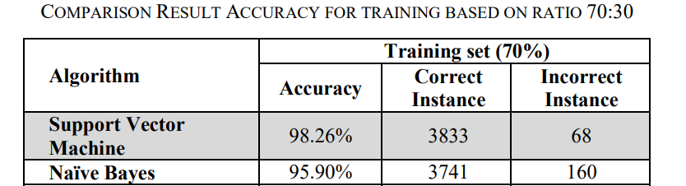

Slide 22
DESIGNING WEBPAGE
Design includes:
Basic HTML & CSS
Flask Framework
A Home Page and A Result Page

Slide 23
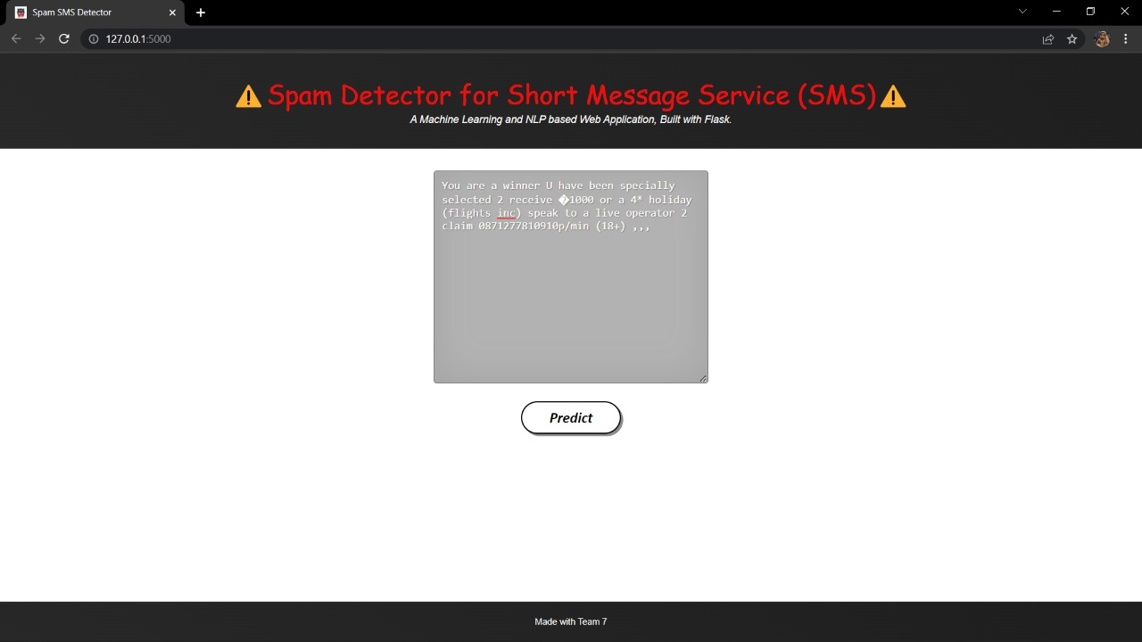
DETECTING SPAM MESSAGE

Slide 24
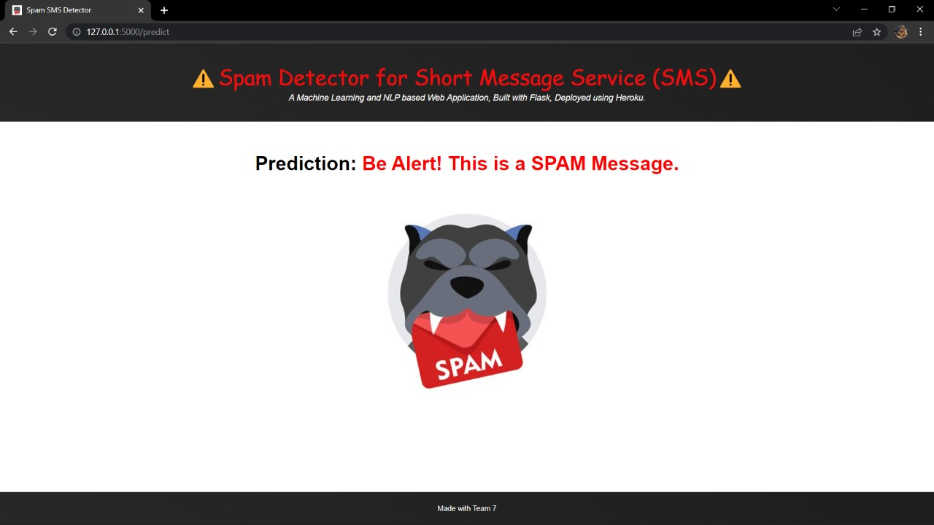
OUTPUT

Slide 25
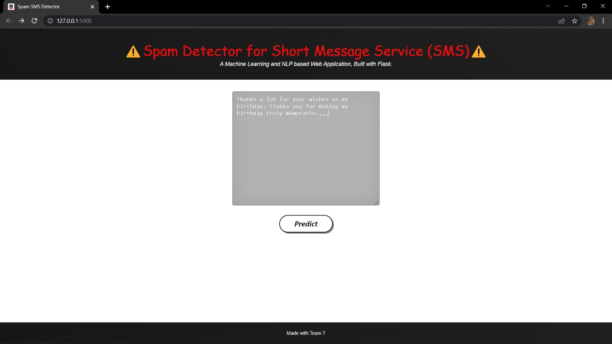
NON SPAM (HAM) MESSAGE

Slide 26
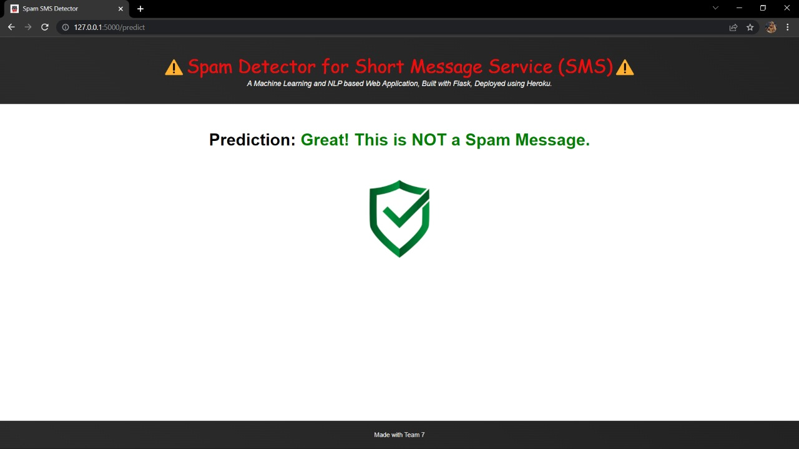
OUTPUT

Slide 27
CONCLUSION
SVM can handle data with a huge number of features. Also, the SVM is often viewed as a critical kernel method, and this is very important in machine learning. The user can either filter spam or continue to receive real SMS. During classifying a collection of datasets, the recommended classifier gets a classification accuracy of 95.32 percent.
Carefully considering all the factors, we identified that Support Vector Machines (SVM) could result in better performance than other classifiers, and it is the most accurate classifier to detect and label the spam messages with an average accuracy is 98.9%. Therefore, this proposed method can be used as the best baseline for further comparison based on SMS spam classification.

Slide 28


